Slide 1


Slide 2
Preface:
History
Goal & Vision
Services & Production
Collaborations and Partners
The funding
Challenges & Solutions
Possibilities
Conclusion

Slide 3
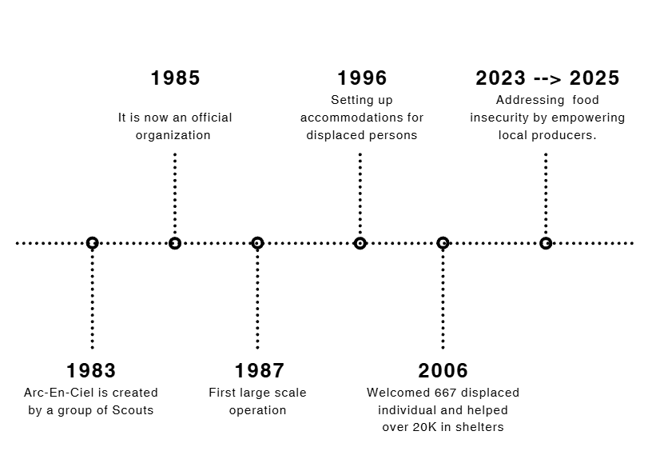
History :

Slide 4
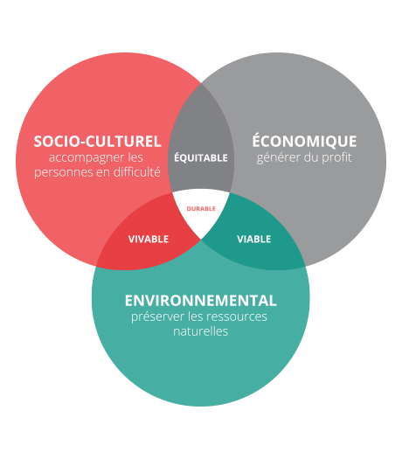
Mission
Goals
Arcenciel promotes sustainable development by integrating marginalized communities into society, empowering individuals with disabilities, embracing diversity, and prioritizing environmental conservation.

Slide 5
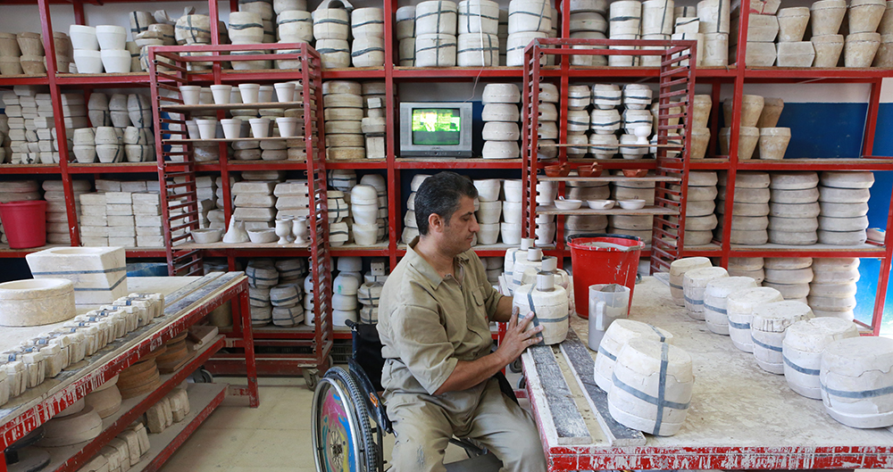
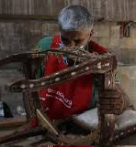
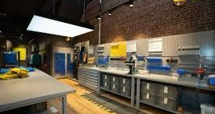
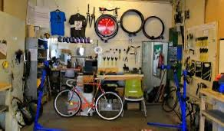

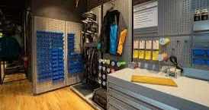
Production
Production:

Slide 6

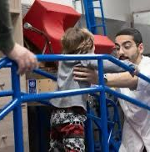

Services:

Slide 7






Collaborations & Partner

Slide 8


Slide 9


Challenges caused by the USAID & How they were managed?

Slide 10

Volunteering activities and opportunities for us:

Slide 11


